Slide 1
Telco Customer Churn Prediction
Data-Driven Strategies for Customer Retention

Slide 2
Agenda
Project Overview
Problem Statement
Data Analysis
Feature Engineering
Model Development
Model Comparison
Key Findings
Business Implications
Recommendations
Implementation Plan
Expected Outcomes
Conclusion

Slide 3

Project Overview
Objective: Develop a predictive model to identify customers at high risk of churning
Scope: Analysis of Telco Customer Churn dataset
Approach:
Exploratory Data Analysis
Feature Engineering
Model Development (Logistic Regression, Gradient Boosting, Random Forest)
Model Comparison and Selection

Slide 4

Problem Statement
Identifying key factors contributing to churn
Predicting potential churners accurately
Developing targeted retention strategies
Impact on business:
Revenue loss
Increased customer acquisition costs
Potential market share decline

Slide 5
Data Analysis - Overview
Dataset: Telco Customer Churn
Features analyzed:
Customer demographics (gender, age range, partners, dependents)
Account information (tenure, contract type, payment method)
Services used (phone, internet, tech support, streaming)
Charges (monthly and total)
Target variable: Churn status (Yes/No)

Slide 6

Data Analysis - Key Insights
Churn rate: 26.5% of customers
Correlation findings:
Strong relationship between contract type and churn
Negative correlation between tenure and churn
Positive correlation between total charges and churn
Visualizations:
Bar chart: Churn rate by contract type
Scatter plot: Tenure vs. Total Charges, colored by churn status

Slide 7

Feature Engineering
New features created:
TotalServices: Sum of all services subscribed
Tenure_Year: Customer tenure in years
AvgMonthlyCharges: Total charges divided by tenure
Tenure_Contract: Interaction between tenure and contract type
MonthlyCharges_InternetService: Interaction between monthly charges and internet service type
Preprocessing steps:
One-hot encoding for categorical variables
Standardization for numerical features

Slide 8
Model Development - Logistic Regression
Performance metrics:
Accuracy: 0.8168
ROC AUC Score: 0.8638
Key features:
Contract type (especially month-to-month)
Tenure
Total charges
Strengths:
High interpretability
Strong baseline performance

Slide 9
Model Development - Gradient Boosting
Performance metrics:
Accuracy: 0.8083
ROC AUC Score: 0.8655
Key features:
Consistent with Logistic Regression
Captured more complex feature relationships
Strengths:
Best at ranking churn probabilities
Robust to outliers

Slide 10

Model Development - Random Forest
Performance metrics:
Accuracy: 0.8034
ROC AUC Score: 0.8541
Key features:
Aligned with other models
Provided additional perspective on feature importance
Strengths:
Captured non-linear relationships
Resistant to overfitting

Slide 11
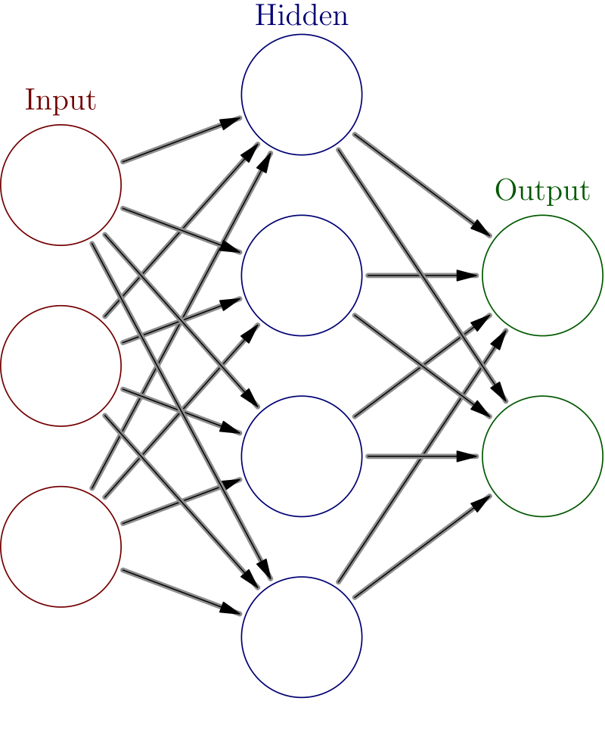
Model Development – Neural Network
Performance metrics:
Accuracy: 0.8154
ROC AUC Score: 0.8627
Key features:
Have some common features
Provided additional perspective on feature importance
Strengths:
Captured non-linear relationships
Resistant to overfitting and better balance between precision and recall

Slide 12

Model Comparison
Performance comparison chart
Metric | Logistic Regression | Gradient Boosting | Random Forest | Neural Network
Accuracy | 0.8168 | 0.8083 | 0.8034 | 0.8124
ROC AUC | 0.8638 | 0.8655 | 0.8541 | 0.8627
F1 Score | 0.6293 | 0.5846 | 0.5553 | 0.6428

Slide 13
Key Findings
Logistic Regression outperformed ensemble methods in accuracy
Gradient Boosting excelled in ranking churn probabilities
Consistent important features across all models:
Contract type
Tenure
Total charges
Month-to-month contracts associated with higher churn risk
Shorter tenure correlated with increased churn probability
Higher total charges linked to greater churn risk

Slide 14
Business Implications
Revenue protection through proactive churn prevention
Cost reduction by focusing on customer retention
Improved customer satisfaction by addressing churn factors
Competitive advantage through data-driven retention strategies
Enhanced understanding of customer behavior and preferences
Potential for increased customer lifetime value

Slide 15

Recommendations
Promote longer-term contracts:
Develop incentives for annual or two-year commitments
Offer discounts or added services for longer contracts
Implement early engagement program:
Specialized onboarding for new customers
Regular check-ins during the first year
Review pricing strategy:
Analyze high total charges and churn relationship
Consider tiered pricing or loyalty discounts
Launch personalized retention campaigns:
Use predictive model to identify high-risk customers
Develop targeted offers based on customer profiles

Slide 16

Implementation Plan
1. Short-term (0-3 months):
Deploy predictive model in pilot program
Develop personalized retention offers
2. Medium-term (3-6 months):
Roll out early engagement program
Implement contract and pricing strategy changes
Launch enhanced loyalty program
3. Long-term (6-12 months):
Fully integrate predictive model into CRM systems
Conduct comprehensive service quality review
Analyze impact and adjust strategies

Slide 17

Expected Outcomes
Reduction in overall churn rate by 20-30% within the first year
Increased average customer lifetime value
Improved customer satisfaction scores
More stable and predictable revenue stream
Enhanced competitive position in the market
Data-driven culture for customer retention strategies

Slide 18
Conclusion
Successful development of accurate churn prediction models
Identification of key factors influencing customer churn
Data-driven recommendations for reducing churn
Clear implementation plan with short, medium, and long-term goals
Potential for significant improvement in customer retention and business performance

